Slide 1
Graphics Programming
Chun-Yuan Lin
CG
115/11/07

Slide 2
The approach in this book for computer graphics is programming oriented.
We introduce a minimal application programmer’s interface (API) to allow you to program many interesting two- and three-dimensional problems and to familiarize you with the basic graphics concepts.
We regard two-dimensional graphics as a special case of three-dimensional graphics. The program code for two-dimensional graphics will execute without modification on a three-dimensional system.
CG
115/11/07

Slide 3
Our development uses a simple but information problem: the Sierpinski gasket. It shows how we can generate an interesting and, to many people, unexpectedly sophisticated image using only a handful of graphics functions.
We use OpenGL, but the discussion of the underlying concepts is broad enough to encompass most modern systems.
CG
115/11/07

Slide 4
The Sierpinski Gasket (1)
We use a sample problem the drawing of the Sierpinski gasket-an interesting shape that has a long history and is of interest in area as fractal geometry.
The sierpinski gasket is an object that can be defined recursively and randomly.
Suppose that we start with three points in space. As long as the points are not collinear, they are the vertices of a unique triangle and also define a unique plane. (we assume that z = 0, three vertices are (x1, y1, 0), (x2, y2, 0), (x3, y3, 0))
CG
115/11/07

Slide 5
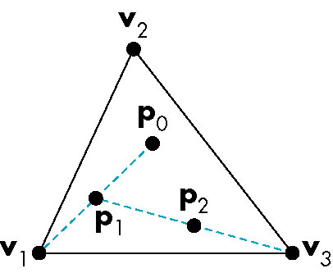
The Sierpinski Gasket (2)
The construction proceeds as follows. Thus each time that we generate a new point, we display it on the output device.
The possible form for the graphics program
might be this:
main()
{
initialize_the_system();
for(some_number_of_points)
{
pt = generate_a_point();
display_the_point (pt);
}
Cleanup();
}
CG
115/11/07

Slide 6
The Sierpinski Gasket (3)
First, we concentrate on the core: generating and displaying points.
We must answer two questions:
  how do we represent points in space?
  Should we use a two-dimensional, three-dimensional, or other representation?
CG
115/11/07

Slide 7
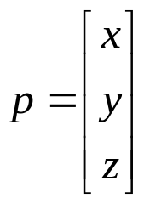
Programming two-dimensional applications (1)
The larger three-dimensional world hold for the simpler two-dimensional world.
We can generate a point in the plane z = 0 as p= (x, y, 0) in the three-dimensional world, or as p = (x, y) in the two-dimensional plane.
OpenGL allows us to use either representation. We can implement representation of points in a number of ways. p= (x, y, z) or a column matrix
CG
115/11/07

Slide 8
Programming two-dimensional applications (2)
We use the terms vertex and point in a somewhat different manner in OpenGL. A vertex is a position in space; we use two-, three-, and four-dimensional space in computer graphics.
  The simplest geometric primitives is a point in space, which is specified by a single vertex.
  Two vertices define a line segment. (a second primitive object)
  Three vertices can determine either a triangle or a circle.
  Four vertices determine a quadrilateral, and so on.
OpenGL has multiple forms for many functions.
CG
115/11/07

Slide 9
Programming two-dimensional applications (3)
For the vertex functions, we can write the general form
glVertex*()
where the * can be interpreted as either two or three characters of the form nt or ntv, where n signifies the number of dimensions (2,3 or 4); t denotes the data type, such as integer (i), float (f), or double (d); and v, if present, indices that the variables are specified through a pointer to an array, rather than through an argument list.
In OpenGL, we often use basic OpenGL types, such as GLfloat and GLint, rahter than the C types, such as float and int.
#define GLfloat float (header file)
(change type without altering existing application program)
CG
115/11/07

Slide 10
Programming two-dimensional applications (4)
If the user wants to work in two-dimensional (three-dimensional) with integers, then the form
glVertex2i (GLint xi, GLint yi)
glVertex3i (GLfloat x, GLfloat y, GLfloat z)
If we use an array to store the information for a three-dimensional vertex.
GLfloat vertex[3], then we can use
glVertex3fv (vertex)
CG
115/11/07

Slide 11
Programming two-dimensional applications (5)
Vertices can define a variety of geometric primitive; different numbers of vertices are required depending on the primitive. We can group as many vertices as we wish between the functions glBegin and glEnd.
glBegin (GL_LINES) glBegin (GL_POINTS)
glVertex3f (x1, y1, z1); glVertex3f (x1, y1, z1);
glVertex3f (x2, y2, z2); glVertex3f (x2, y2, z2);
glEnd(); glEnd();
If we assume z =0,
glVertex3f (x, y, 0) or glVertex2f (x, y)
CG
115/11/07

Slide 12
Programming two-dimensional applications (6)
We could also define a new data type
typedef GLfloat point2[2];
point2 p;
glVertex2fv (p);
Returning to the sierpinski gasket, we create a function, called display. We assume that an array of triangle vertices vertices[3] is defined in display.
CG
115/11/07

Slide 13
Programming two-dimensional applications (7)
Void display ()
{
GLfloat vertices[3][3] = {{0.0, 0.0, 0.0}, {25.0, 50.0, 0.0}, {50.0, 0.0, 0.0}};
GLfloat p[3] = {7.5, 5.0, 0.0};
int j,k;
int rand();
glBegin(GL_POINTS)
for (k=0, k <5000; k++)
{
j= rand() % 3;
p[0]= (p[0] + vertices[j][0])/2;
p[1]= (p[1] + vertices[j][1])/2;
glVertex3fv (p);
}
glEnd();
glFlush();
}
The function rand is a standard random number generator.
glFlush ensures that points are rendered to the screen as soon
as possible.
CG
115/11/07

Slide 14
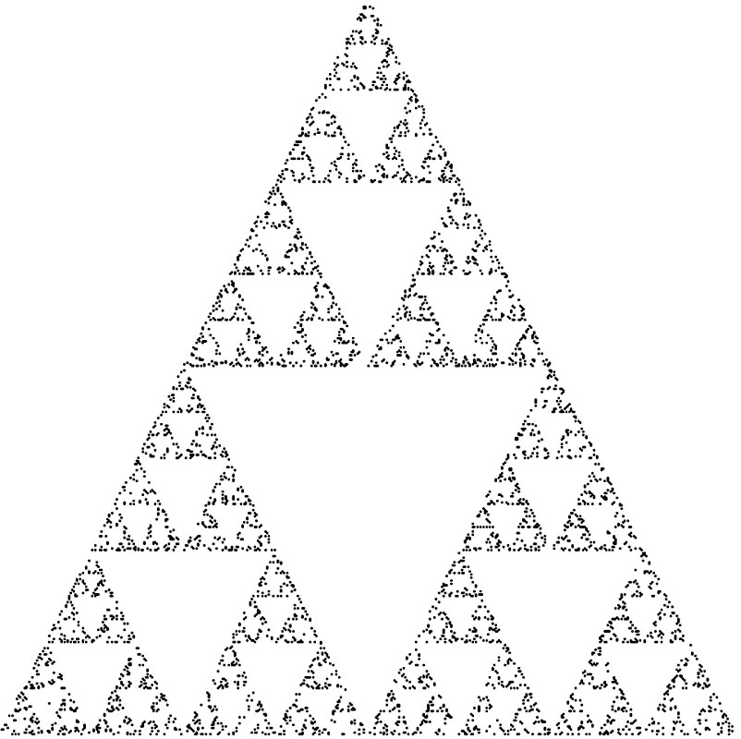
Programming two-dimensional applications (8)
We still do not have a complete program.
CG
115/11/07

Slide 15
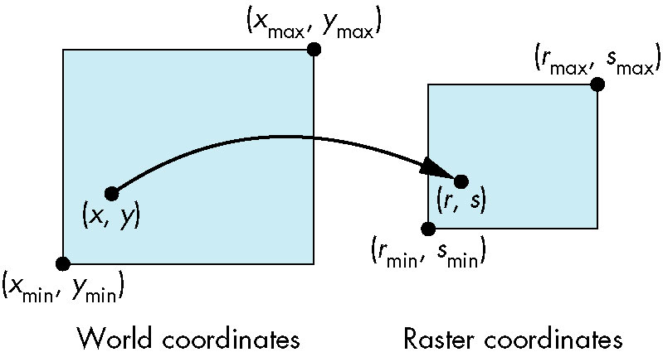
Programming two-dimensional applications (9)
Coordinate systems
  Originally, graphics systems required the user to specify all information, such as vertex locations, directly in units of the display device.
  The user’s coordinate system became known as the world coordinate system or the application model, or object coordinate system.
  Units on the display were first called physical-device coordinates or just device coordinate.
  For raster devices, such as most CRT displays, we use the term window coordinates or screen coordinates.
CG
115/11/07

Slide 16

The OpenGL API (1)
OpenGL’s structure is similar to that of most modern APIs, including Java3D and DirectX.
Graphics Functions
  The basic model of a graphics package is a black box, a term that engineers use to denote a system whose properties are described only by its inputs and outputs.
  We can think of the graphics system as a box.
CG
115/11/07

Slide 17
The OpenGL API (2)
  A good API may contain hundreds of functions, so it is helpful to divide them into seven major groups.
    Primitive functions
    Attribute functions
    Viewing functions
    Transformation functions
    Input functions
    Control functions
    Query functions
    The primitive functions define the low level objects or atomic entities that the system can display.
    The viewing functions allow us to specify various views, although APIs differ in the degree of flexibility they provide in choosing a view.
CG
115/11/07

Slide 18
The OpenGL API (3)
    Attribute functions allow us to perform operations ranging from choosing the color with which we display a line segment, to picking a pattern with which to fill the inside of a polygon.
    One of the characteristics of a good APIs is that it provides the user with a set of transformation functions that allows her to carry out transformations of objects, such as rotation, etc.
    For interactive applications, an API must provide a set of input functions to allow us to deal with the diverse forms of input that characterize modern graphics systems.
    The control functions enable us to communicate with the window system, to initialize the programs, and to deal with any errors.
    A good APIs provides particular implementation information through a set of query functions.
CG
115/11/07

Slide 19
The OpenGL API (4)
The graphics pipeline and state machine
  We can think that the entire graphics system as a state machine, a black box that contains a finite-state machine.
  This state machine has inputs that come from the application program.
  These inputs may change the state of the machine or can cause the machine to produce a visible output.
  One important consequence of this view is that in OpenGL, most parameters are persistent; their values remain unchanged until we explicitly change them through functions that alter the state.
CG
115/11/07

Slide 20
The OpenGL API (5)
The OpenGL Interface
  Most of the applications will be designed to access OpenGL, directly through functions in three libraries.
  Functions in the main GL (or OpenGL in windows) library have names that begin with the letter gl.
  The second is the OpenGL Utility Library (GLU). This library uses only GL functions but contains code for creating common objects and simplifying viewing. (with the letters glu)
  To interface with the window system and to get input from external devices into our programs, we need at least one more library. OpenGL Utility Toolkit (GLUT) provides the minimum functionality that should be expected in any modern windowing system. (with the letters glut)
CG
115/11/07

Slide 21
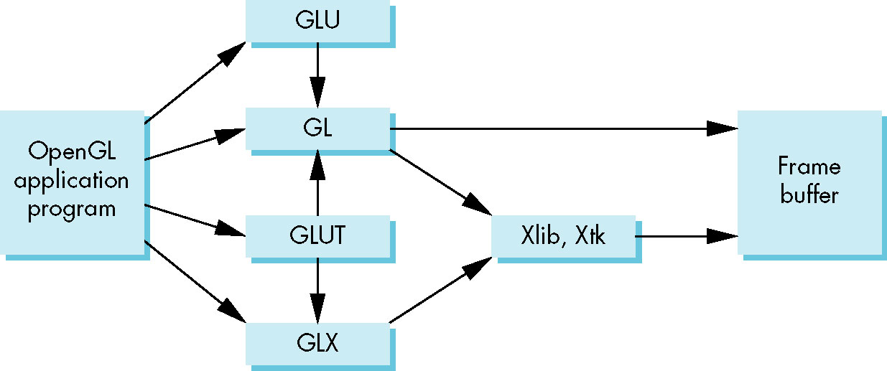
The OpenGL API (6)
In most implementations, one of the include lines
#include <GL/glut.h> or
#include <GLUT/glut.h>
is sufficient to read in glut.h, gl.h, glu.h.
CG
115/11/07

Slide 22
Primitives and Attributes (1)
Primitives should be supported by API. (debate)
API should contain a small set of primitives that all hardware can be expected to support.
The OpenGL takes an intermediate position. The basic library has a small set of primitives. The GLU library contains a richer set of objects derived from the basic library.
OpenGL supports two classes of primitives: geometric primitives and image, or raster, primitives.
CG
115/11/07

Slide 23
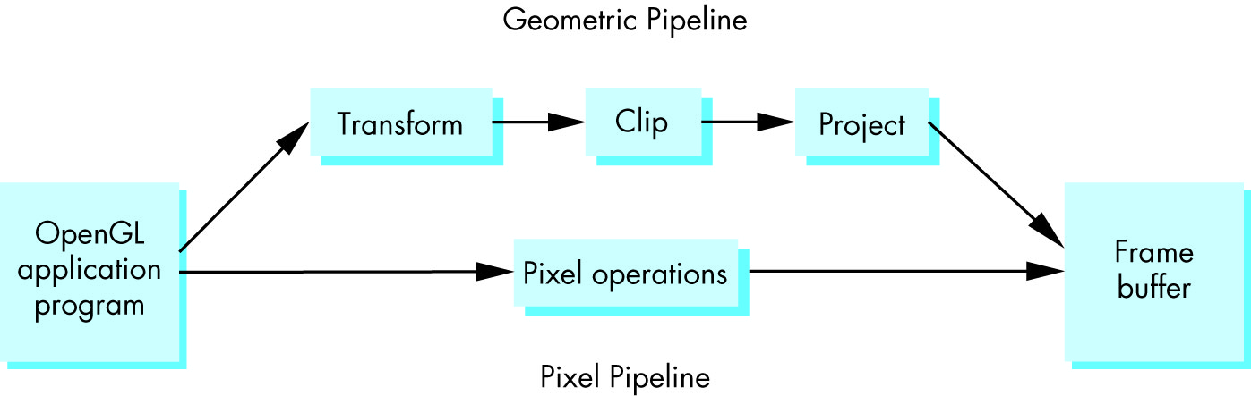
Primitives and Attributes (2)
Geometric primitives are specified in the problem domain and include points, line segments polygons, curves, and surfaces. These primitives pass through a geometric pipeline as below.
Geometric primitives exist in a two- or three-dimensional space, they can be manipulated by operations, such as rotation.
CG
115/11/07

Slide 24
Primitives and Attributes (3)
Raster primitives, such as arrays of pixels, lack geometric properties and cannot be manipulated in space in the same way as geometric primitives.
The basic OpenGL geometric primitives are specified by sets of vertices.
glBegin (type)
glVertex* (…);
.
.
glVertex* (…);
glEnd();
The value of type specifies how OpenGL assembles
the vertices to define geometric objects.
All the basic types are defined by sets of vertices.
CG
115/11/07

Slide 25
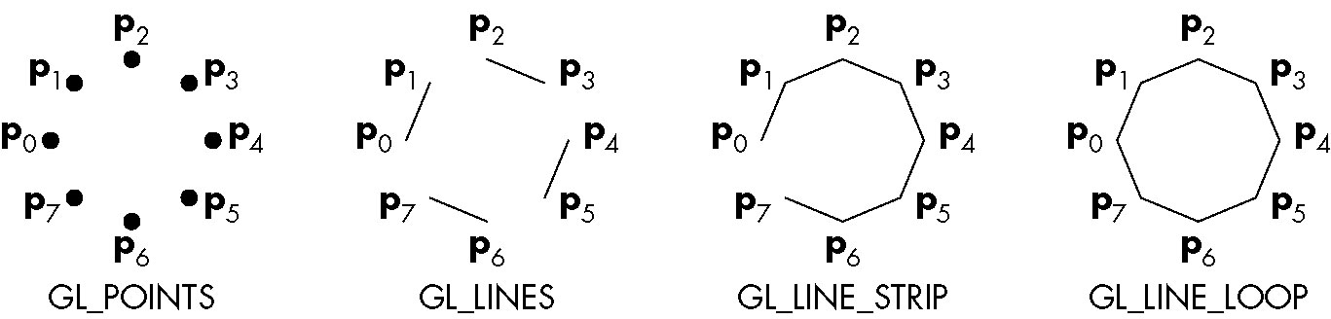
Primitives and Attributes (4)
Finite sections of lines between two vertices, called line segments.
If we wish to display points or line segments, we have a few objects in OpenGL. The primitives and their type specifications include the following.
  Points (GL_POINTS)
  Line segments (GL_LINES)
  Polylines (GL_LINE_STRIP, GL_LINE_LOOP)
CG
115/11/07

Slide 26
Primitives and Attributes (5)
Polygon Basics
  Line segments and polylines can model the edges of objects, but closed objects also may have interiors.
  Usually we reserve the name polygon for an object that has a border that can be described by a line loop but also has a well-defined interior.
  The performance of graphics systems is characterized by the number of polygons per second that can be rendered.
  We can render a polygon in a variety of ways;
    we can render only its edges;
    we can render its interior with a solid color or a pattern.
    we can render or not render the edges.
  Three properties will ensure that a polygon will be displayed correctly; it must be simple, convex, and flat.
CG
115/11/07

Slide 27
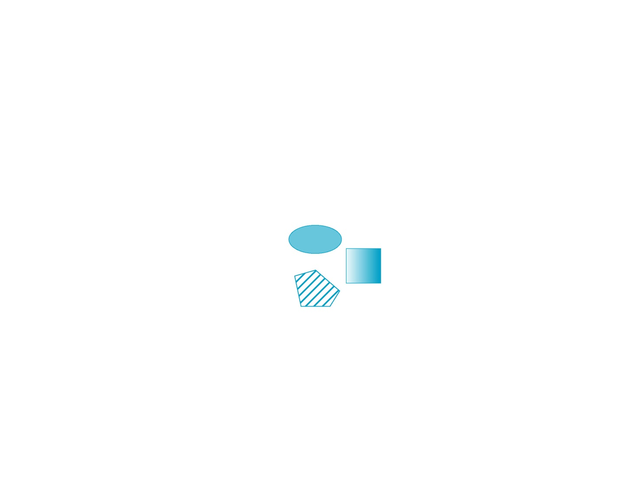

CG
115/11/07

Slide 28
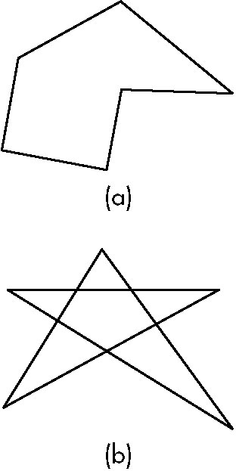
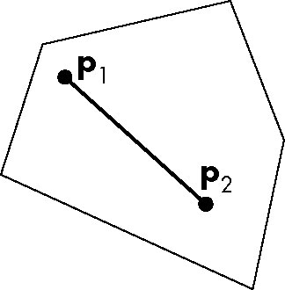
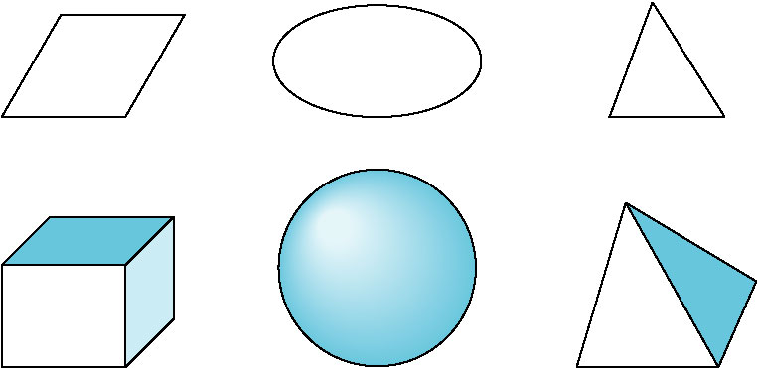
Primitives and Attributes (6)
In two-dimensions, as long as no two edges of a polygon cross each other, we have a simple polygon. (the cost of testing is high)
An object is convex if all points on the line segment between any two points inside the object, or on its boundary, are inside the object. (convexity testing is expensive)
CG
115/11/07

Slide 29
Primitives and Attributes (7)
In three-dimensions, polygon present a few more difficulties because, unlike all two-dimensional objects, all the vertices that define the polygon need not lie in the same plane. We always use triangles.
Polygon Types in OpenGL
  For objects with interior, we can specify the following types.
    Polygons (GL_POLYGON):
    The edges are the same as they would be if we used line loops.
    We can use the function glPolygonMode to tell the renderer to generate only the edges or just points for the vertices, instead of fill.
    Twice for fill and the edge.
CG
115/11/07

Slide 30
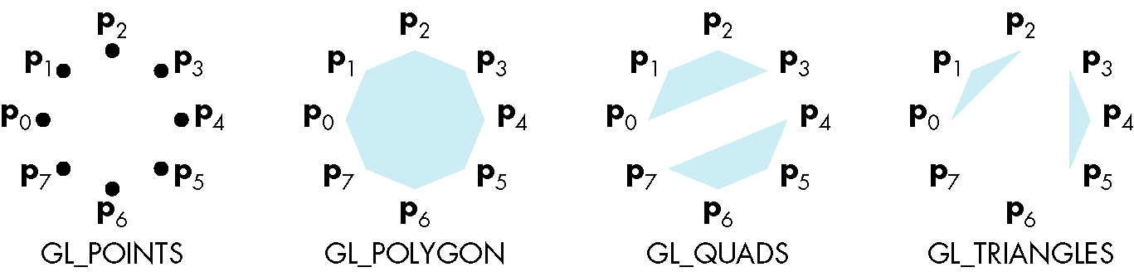
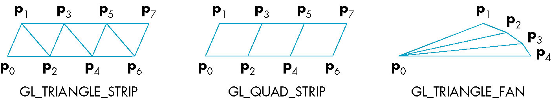
Primitives and Attributes (8)
    Triangles and Quadrilaterals (GL_TRIANGLES, GL_QUADS)
    Strips and Fans (GL_TRIANGLE_STRIP, GL_QUAD_STRIP, GL_TRIANGLE_FAN)
    In the triangle strip for example, each additional vertex is combined with the previous two vertices to define a new triangle.
CG
115/11/07

Slide 31
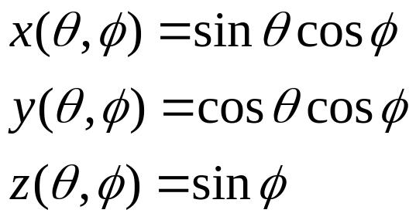
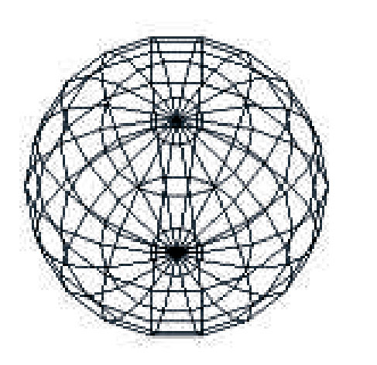
Primitives and Attributes (9)
Approximating a Sphere
  Fans and strips allow us to approximate many curved surfaces simply.
  Consider a unit sphere, we can describe it by the following three equations. (we can use quadrilaterals or two triangle fans to present it)
CG
115/11/07

Slide 32
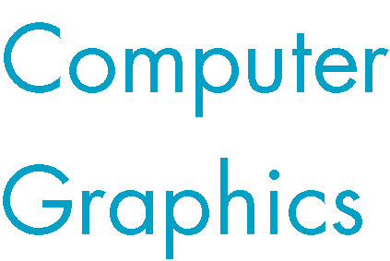
Primitives and Attributes (10)
Text
  Graphical outputs in applications such as data analysis and display require annotation, such as labeled on graphics.
  Text in computer graphics is problematic.
  Fonts are families of typefaces of a particular style.
  There are two forms of text: stroke and raster.
  Stroke text is constructed as are other geometric objects. (can be manipulate and view like any other primitives) (PostScript)
CG
115/11/07

Slide 33
Primitives and Attributes (11)
  Raster text is simple and fast. Characters are defined as rectangles of bits called bit blocks. Each block defines a single character by the pattern of 0 and 1 bits in the block. A raster character can be placed in the frame buffer rapidly by a bit-block-transfer (bitblt) operation which moves the block of bits using a single function call.
  You can increase the size of raster characters by replicating or duplications pixels, a process that gives larger characters a blocky appearance.
  OpenGL does not have a text primitive. However, GLUT library provides a few predefined bitmap and stroke character sets that defined in software and are portable.
  glutBitmapCharacter(GLUT_BITMAP_8_BY_13, c);
  glRasterPos* to define the position.
CG
115/11/07

Slide 34
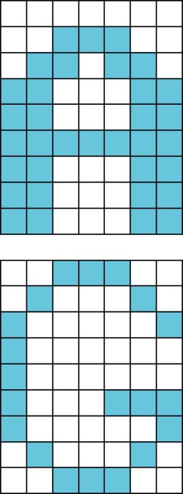
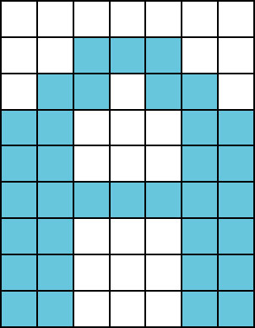
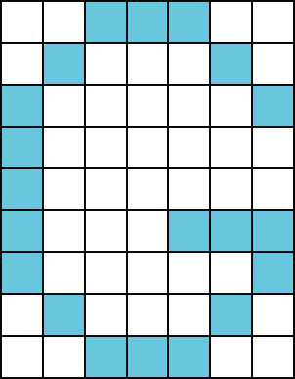

CG
115/11/07

Slide 35
Primitives and Attributes (12)
Curved Objects
  The primitives in the basic set have all been defined through vertices.
  We can take two approaches to creating a richer set of objects.
    First, we can use the primitives that we have to approximate curves and surfaces. (by a mesh of convex polygons)
    The other approach is to start with the mathematical definitions of curved objects, and then build graphics functions to implement those objects.
    In OpenGL, we can use the GLU and GLUT libraries for a collection of approximations to common curved surfaces, and we can write functions to define more of our own.
Attributes
  In a modern graphics system, there is a distinction between the type of a primitive and how that primitive is rendered.
CG
115/11/07

Slide 36
Primitives and Attributes (13)
A red solid line and a green dashed line are the same geometric type, but they are rendered differently.
An attribute is any property that determines how a geometric primitive is to be rendered.
Attributes may be associated with primitives at various points in the modeling and rendering pipeline.
In immediate mode, primitives are not stored in the system but rather passed through the system for possible rendering as soon as they defined.
CG
115/11/07

Slide 37
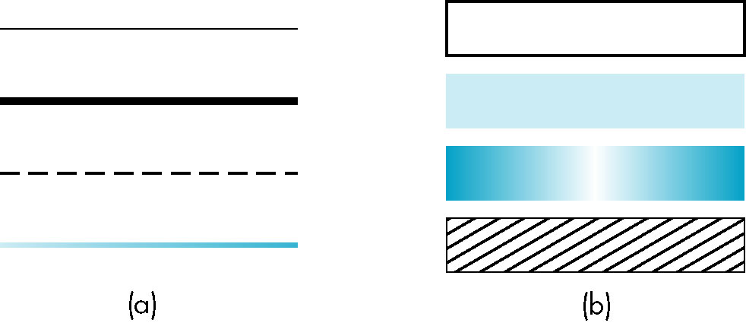
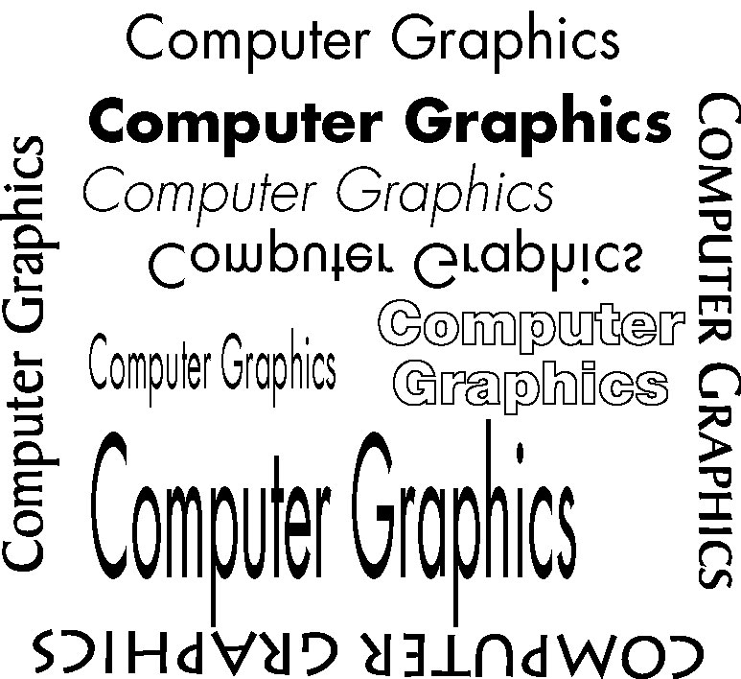
CG
115/11/07

Slide 38
Primitives and Attributes (14)
OpenGL’s emphasis on immediate-mode graphics and a pipeline architecture works well for interactive applications, but they emphasis is a fundamental difference between OpenGL and object-oriented systems in which objects can be created and recalled as desired.
Each geometric type has a set of attributes.
CG
115/11/07

Slide 39
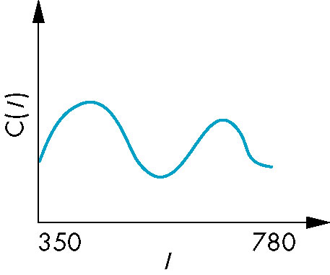
COLOR (1)
Color is one of the most interesting aspect of both human and computer graphics.
A visible color can be characterized by a function C(λ) that occupies wavelengths from about 350 to 780nm. The value for a given wavelength λ in the visible spectrum gives the intensity of that wavelength in the color.
A consequence of this tenet is that, in principle,
a display needs only three primary colors to
produce the three tristimulus values needed for
a human observer.
CG
115/11/07

Slide 40
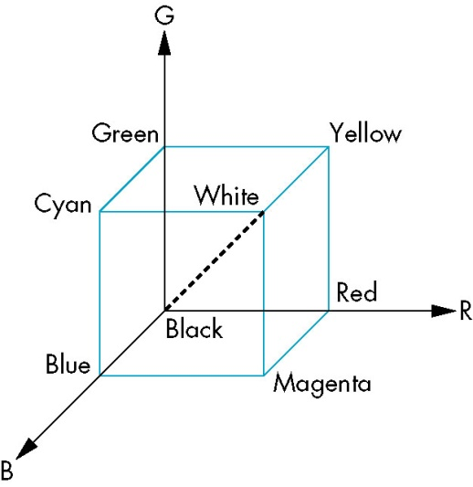
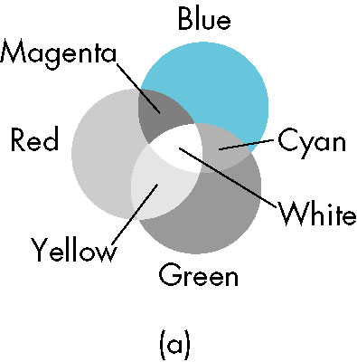
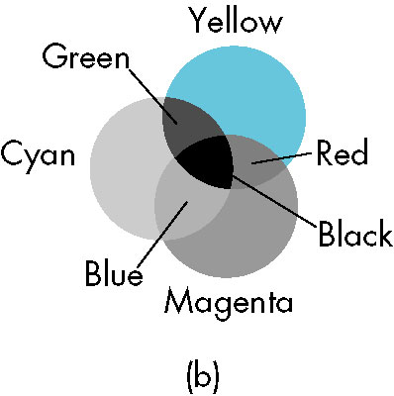
COLOR (2)
The CRT is one example of additive color where the primary colors add together to give the perceived color.
For process, such as commercial printing and painting, a subtractive color model is more appropriate. In subtractive systems, the primaries are usually the complementary colors, cyan, magenta and yellow. We can view a color as a point in a color solid.
CG
115/11/07

Slide 41
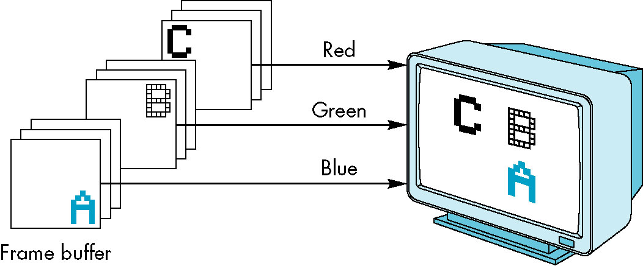
COLOR (3)
RGB color
  Now we can look at how color is handled in a graphic system from the programmer’s perspective.
  There are two different approaches. We will stress the RGB-color mode.
  In a three-primary color, additive-color RGB system, there are conceptually separate buffers for red, green, and blue images.
  As programmers, we would like to be able to specify any color that can be stored in the frame buffer. (24 bits)
  A natural techniques is to use the color cube and to specify color components as numbers between 0.0 and 1.0, where 1.0 denotes the maximum value.
CG
115/11/07

Slide 42
COLOR (4)
  To draw in red, we issue the following function call.
  glColor3f (1.0, 0.0, 0.0);
  Because the color is part of the state, we continue to draw in red until the color is changed.
  We shall be interesting in a four-color (RGBA) system.
    The fourth color (A or alpha) also is stored in the frame buffer as are the RGB values; it can be set with four-dimensional versions of the color functions.
    If blending us enabled, then the alpha value will be treated by OpenGL as either an opacity or transparency value.
    Opacity values can range from fully transparent (A= 0.0) to fully opaque (A= 1.0)
  One of the first tasks that we must do in a program is to clear an area of the screen-a drawing window-in which to display the output.
  glClearColor(1.0, 1.0, 1.0, 1.0); (make the window on the screen solid and white)
CG
115/11/07

Slide 43
COLOR (5)
Indexed Color
  Early graphics systems had frame buffers that were limited in depth.
  Indexed color provided a solution that allowed applications to display a wide range of colors as long as the application did not need more colors than could be referenced by a pixel.
  We can argue that if we can choose for each application a limited number of colors from a large selection, we should be able to create good-quality image most of the time.
    Suppose that the frame buffer has k bits per pixel. Each pixel value or index is an integer between 0 and 2^{k}-1.
    Suppose that we can display colors with a precision of m bits; that is, we can choose from 2^{m} reds, 2^{m} greens, 2^{m} blues. Hence, we can produce any 2^{3m} of colors on the display. (but the frame buffer can specify only 2^{k} of them) (color-lookup table)
CG
115/11/07

Slide 44
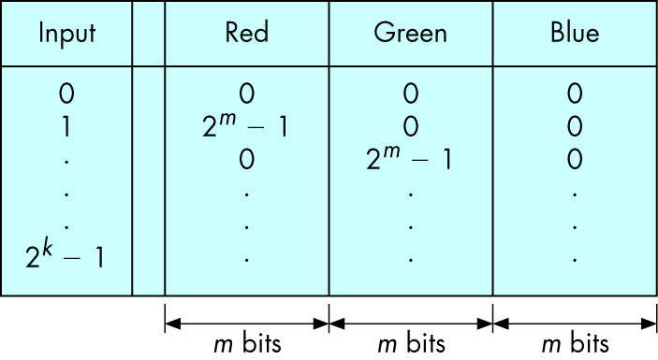
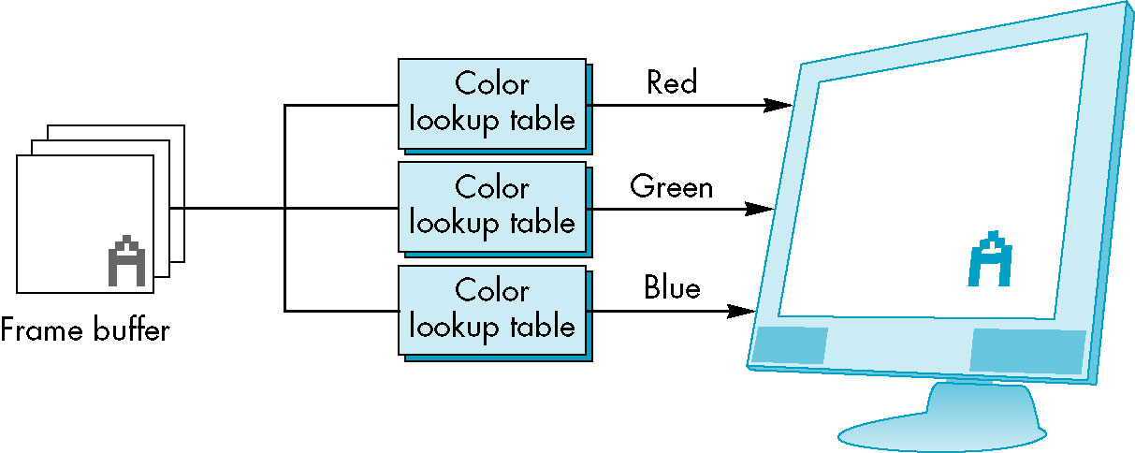
CG
115/11/07

Slide 45
COLOR (6)
If we are in color-index mode, the present color is selected by a function such as glIndexi(element); that selects a particular color out of the table.
GLUT allows us to set the entries in a color table for each window through the following function:
glutSetColors (int color, GLfloat red, GLfloat green, GLfloat blue)
Color-index mode was important because it required less memory for the frame buffer and fewer other hardware components.
Consequently, for the most part, we will assume that we are using RGB color.
CG
115/11/07

Slide 46
COLOR (7)
Setting of Color Attributes
  The first is the clear color
  glClearColor (1.0, 1.0, 1.0, 1.0);
  Setting the color
  glColor3f(1.0, 0.0, 0.0);
  Set the size of rendered points to be 2 pixel wide
  glPointSize (2.0); (Line?)
  Note that attributes, such as point size, are specified in terms of the pixel size (hardware dependent)
CG
115/11/07

Slide 47
Viewing (1)
We can now put a variety of graphical information into the world, and we can describe how we would like these objects to appear, but we do not yet have a method for specifying exactly which of these objects should appear on the screen.
A fundamental concept that emerges from the synthetic-camera model. Once we have specified both the scene and the camera, we can compose a image.
The Orthographic View
  The simplest and OpenGL’s default view is the orthographic projection.
CG
115/11/07

Slide 48
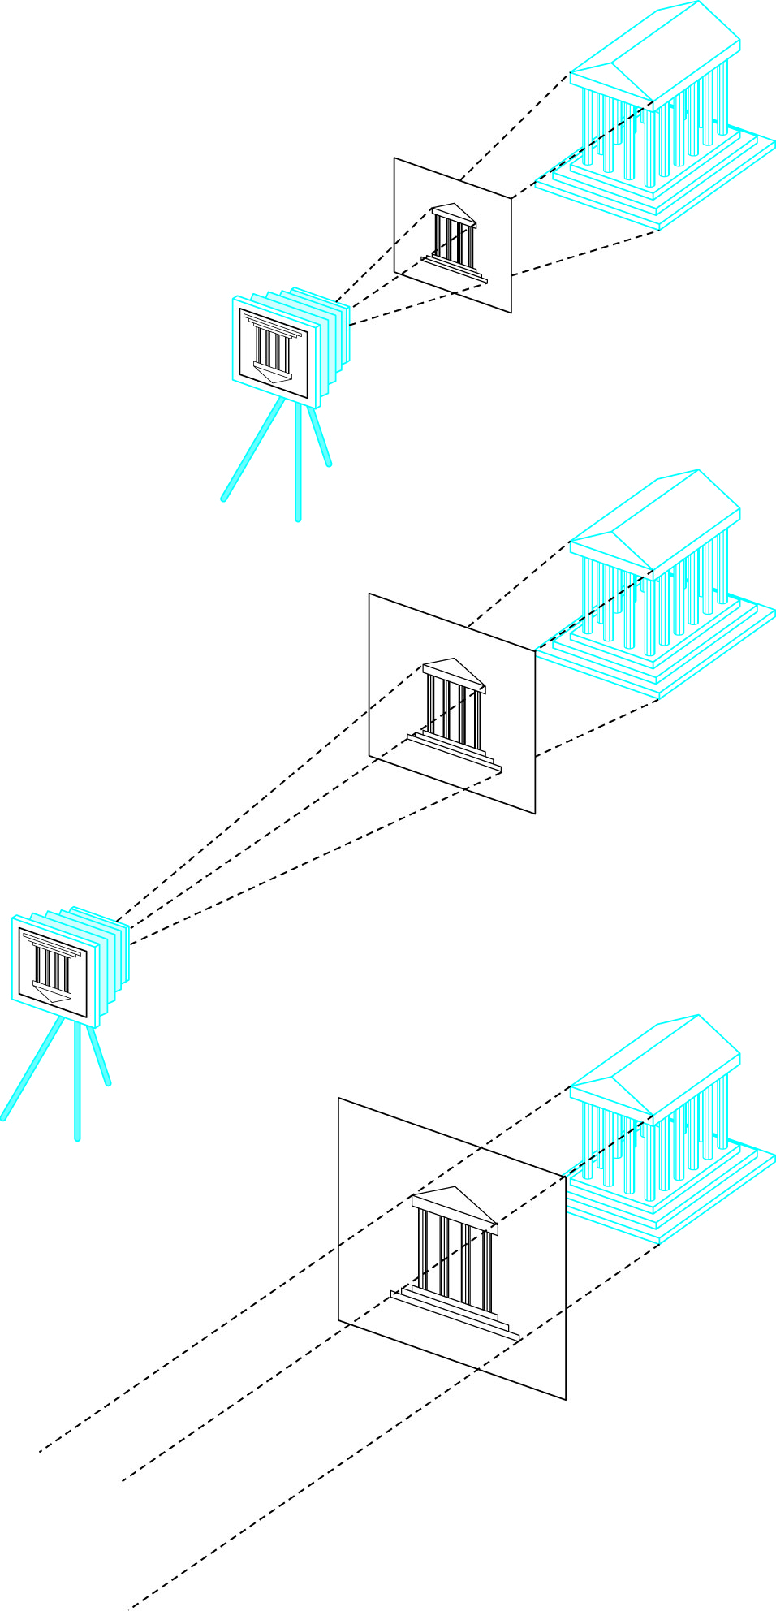
Viewing (2)
  Mathematically, the orthographic projection
  is what we would get if the camera in the
  synthetic camera model had an infinitely
  long telephoto lens and we could then place
  the camera infinitely far from the objects.
  In the limit, all the projectors become
  parallel and the center of projection is
  replaced by a direction of projection.
  In OpenGL, the reference point (in the
  projection plane) starts off at
  the origin and the camera points in the
  negative z-direction.
CG
115/11/07

Slide 49
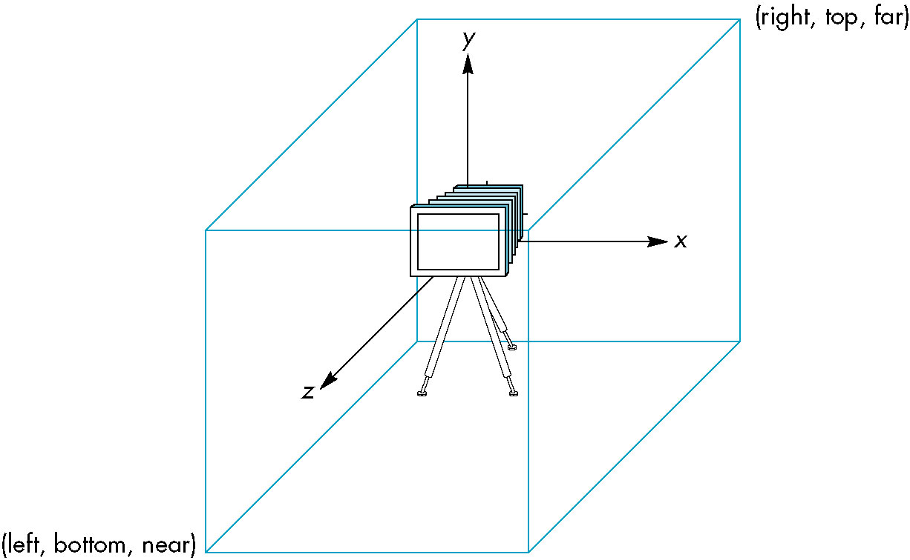
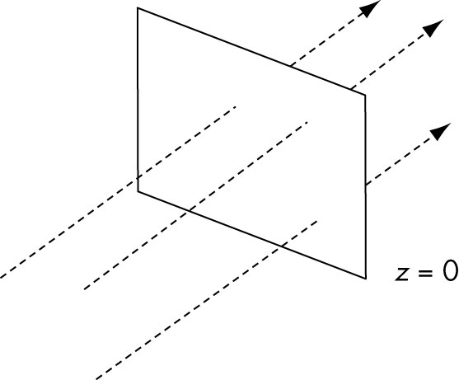
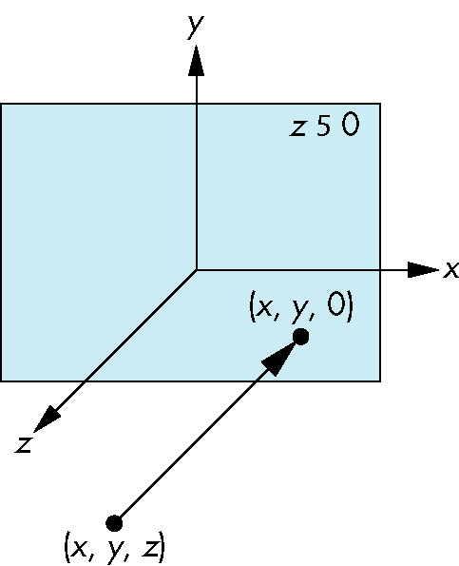
CG
115/11/07

Slide 50
Viewing (3)
  In OpenGL, an orthographic projection with a right-parallelepiped viewing volume is specified via the following:
void glOrtho (GLdouble left, GLdouble right, GLdouble bottom,
GLdouble top, GLdouble near, GLdouble far)
(all the parameters are distances measured from the camera)
  OpenGL uses its default, a 2 ×2 ×2 cube, with the origin in the center. In terms of the two-dimensional plane, the bottom-left corner is at (-1.0, -1.0), and the upper-right corner is at (1.0, 1.0).
Two-Dimensional Viewing
    The viewing rectangle is in the plane z = 0 within a three-dimensional viewing volume.
CG
115/11/07

Slide 51
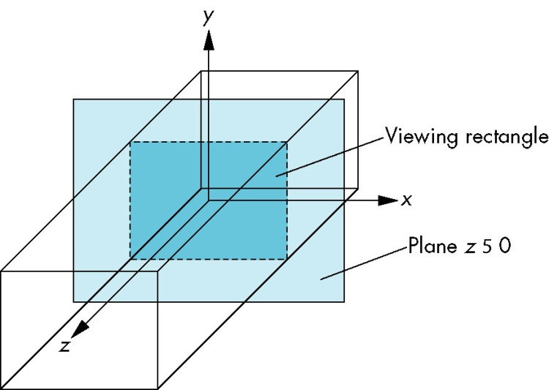
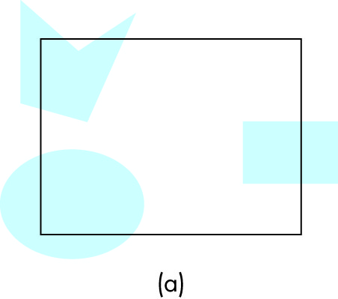
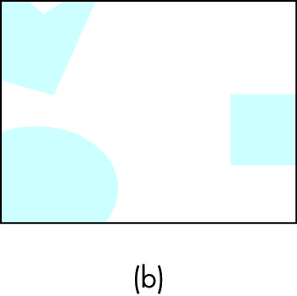
Viewing (4)
  void gluOrtho2D (GLdouble left, GLdouble right, GLdouble
bottom, GLdouble top)
  This function is equivalent to glOrtho, with near and far set to -1.0 and 1.0.
  The area of the world that we image is known as the viewing rectangle, or clipping rectangle. Objects inside the rectangle are in the image; objects outside are clipped out and are not displayed.
CG
115/11/07

Slide 52
Viewing (5)
Matrix Modes
  Pipeline graphics systems have an architecture that depends on multiplying together, or concatenating, a number of transformation matrices to achieve the desired image.
  The two most important matrices are the model-view and projection matrices.
  At any time, the state includes values for both of these matrices, which are initially set to identity matrices.
  There is only a single set of functions that can be applied to any type of matrix. We select the matrix to which the operations apply by first setting the matrix mode, a variable that is set to one type of matrix and is also part of the state.
CG
115/11/07

Slide 53
Viewing (6)
  The default matrix mode is to have operations apply to the model-view matrix, so to alter the projection matrix, we must first switch modes.
  The following sequence is common for setting a two-dimensional viewing rectangle.
  glMatrixMode(GL_PROJECTION);
  glLoadIdentity();
  gluOrtho2D(0.0, 50.0, 0.0, 50.0);
  glMatrixMode(GL_MODELVIEW);
  This sequence defines a 50.0×50.0 viewing rectangle with the lower-left corner of the rectangle at the origin of the two-dimensional system. It then switch the matrix mode back to model view mode.
CG
115/11/07

Slide 54
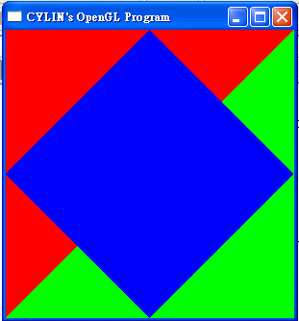
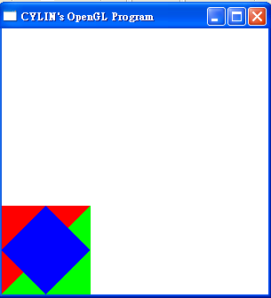
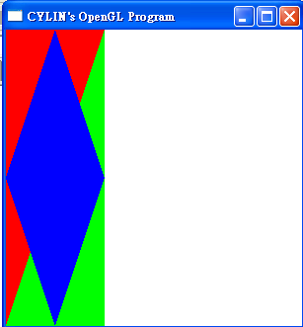
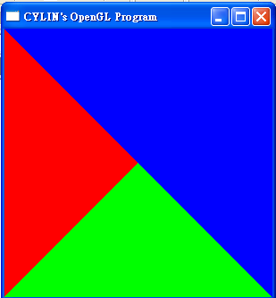
CG
115/11/07

Slide 55
Control Functions (1)
Exploitation of the possibilities open to the application programmer requires knowledge specific to these systems.
OpenGL Utility Toolkit (GLUT); it is a library of functions that provides a simple interface between the systems. (GLUT will help us to understand the interactions that characterize modern interactive graphics systems, including a wide range of APIs, operating systems, and window systems)
Interaction with the Window System
  We use window, or screen window, to denote a rectangle area of the display. We are concerned only with raster displays.
CG
115/11/07

Slide 56
Control Functions (2)
  A window has a height and width. Positions in the window are measured in window or screen coordinates, where the units are pixels.
  We use the term window system to refer to the multiwindow environment provided by systems such as the X window system and Microsoft windows. The window in which the graphics output appears is one of the window managed by the window system.
  The graphics window is a particular type of window-one in which graphics can be displayed or rendered.
  In science and engineering, the lower-left corner is the origin and has window coordinates (0,0).
  However, virtually all raster system display their screens in the same way as commercial television system do-from top to bottom, left to right. The top-left corner should be the origin.
CG
115/11/07

Slide 57
Control Functions (3)
  OpenGL commands assume that the origin is bottom-left, whereas information returned from the windowing system, such as the mouse position, often as the origin at the top left and thus requires us to convert the position from one coordinate system to the other.
  Although the screen may have a resolution of say, 1280×1024 pixels, the window that we use can have any size. The frame buffer must have a resolution equal to the screen size. (even only use a part of the real frame buffer)
  Before we can open a window, there must be interaction between the windowing system and OpenGL.
  glutInit (int *argcv, char **argv)
CG
115/11/07

Slide 58
Control Functions (4)
  We can open an OpenGL window using the GLUT function.
  glutCreateWindow (char *title)
  where the title at the top of window is given by the string title.
  We can also use GLUT functions before window creation to specify these parameters.
  glutInitDisplayMode(GLUT_RGB|GLUT_DEPTH|GLUT_DOUBLE);
  glutInitWindowSize(640, 480);
  glutInitWindowPosition(0,0);
  specifies a 480×640 window in the top-left corner of the display.
Aspect Ratio and Viewports
CG
115/11/07

Slide 59
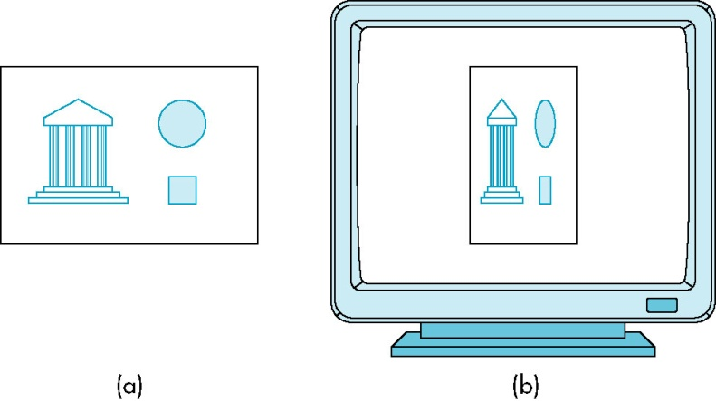
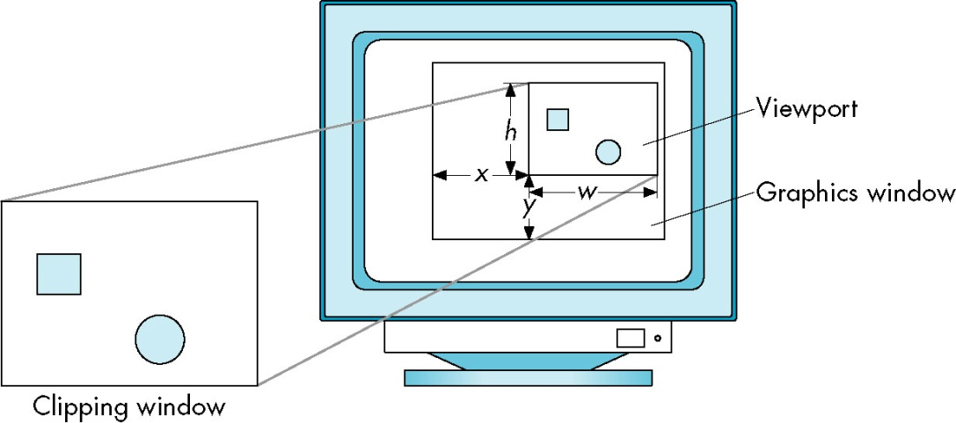
Control Functions (5)
  The aspect ratio of a rectangle is the ratio of the rectangle’s width to its height.
  If the aspect ratio of the viewing rectangle specified by glOrtho, is not the same as the aspect ratio of the window specified by glutInitWindowSize, objects are distorted on the screen.
CG
115/11/07

Slide 60
Control Functions (6)
  Another, more flexible, method is to use the concept of a viewport. A viewport is a rectangular area of the display window. By the default, it is the entire window, but it can be set to any smaller size in pixels via the function.
  void glViewport (GLint x, GLint y, GLint w, GLint h)
  where (x, y) is the lower-left corner of the viewpoint, and w and h give the height and width.
  The types are all integers that allow us to specify positions and distances in pixels.
  The viewport is part of the state. (change to change other viewport)
The main, display, and myinit Functions
CG
115/11/07

Slide 61
Control Functions (7)
  In principle, we should be able to combine the simple initialization code with the code from section 2.1 to form a complete OpenGL program for the Sierpinski gasket. (without generic and interactive)
  In immediate-mode graphics, a primitives is rendered into the frame buffer as soon it specified.
  We can use the GLUT funcion
  void glutMainLoop();
  whose execution will cause the program to begin an event-processing loop. If there are no events to process, the program will sit in a wait state. (until we terminate the program)
  Graphics are sent to the screen through a function called the display callback.
  void glutDisplayFunc(void (*func)(void))
CG
115/11/07

Slide 62
Control Functions (8)
We use an initialization function myinit() to set the OpenGL state variables dealing with viewing and attributes-parameters that we prefer to set once, independently of the display function.
In most implementation (in C language), the compiler directive
#include<stdlib.h>
#include<stdio.h>
#include<time.h>
#include <GL/glut.h>
should be included in the program.
CG
115/11/07

Slide 63
Control Functions (9)
int main(int argc, char** argv)
{
/* Standard GLUT initialization */
glutInit(&argc,argv);
glutInitDisplayMode (GLUT_SINGLE | GLUT_RGB); /* default, not needed */
glutInitWindowSize(500,500); /* 500 x 500 pixel window */
glutInitWindowPosition(0,0); /* place window top left on display */
glutCreateWindow("Sierpinski Gasket"); /* window title */
glutDisplayFunc(display); /* display callback invoked when window opened */
myinit(); /* set attributes */
glutMainLoop(); /* enter event loop */
}
CG
115/11/07

Slide 64
Control Functions (10)
Program Structure
  Every program we write will have the same structure as the gasket program.
  We will always use the GLUT toolkit.
  The main function will then consist of calls to GLUT functions to set up the window and to make sure that the local environment supports the required display properties.
  Every program must have a display callback, and most will have other callbacks to set up interaction.
  The myinit function will set up user options, usually through OpenGL functions on the GL and GLU libraries.
CG
115/11/07

Slide 65
The Gasket Program
Using the main function, we can now write the myinit and display functions and thus complete the program that generate the Sierpinski gasket.
CG
115/11/07

Slide 66
#include<stdlib.h>
#include<stdio.h>
#include<time.h>
#include <GL/glut.h>
void myinit()
{
/* attributes */
glClearColor(1.0, 1.0, 1.0, 1.0); /* white background */
glColor3f(1.0, 0.0, 0.0); /* draw in red */
/* set up viewing */
/* 500 x 500 window with origin lower left */
glMatrixMode(GL_PROJECTION);
glLoadIdentity();
gluOrtho2D(0.0, 50.0, 0.0, 50.0);
glMatrixMode(GL_MODELVIEW);
}
CG
115/11/07

Slide 67
void display( void )
{
GLfloat vertices[3][2]={{0.0,0.0},{25.0,50.0},{50.0,0.0}}; /* A triangle */
int j, k;
GLfloat p[2] ={7.5,5.0}; /* An arbitrary initial point inside traingle */
glClear(GL_COLOR_BUFFER_BIT); /*clear the window */
/* compute and plots 5000 new points */
glBegin(GL_POINTS);
for( k=0; k<5000; k++)
{
j=rand()%3; /* pick a vertex at random */
/* Compute point halfway between selected vertex and old point */
p[0] = (p[0]+vertices[j][0])/2.0;
p[1] = (p[1]+vertices[j][1])/2.0;
/* plot new point */
glVertex2fv(p);
}
glEnd();
glFlush(); /* clear buffers */
}
CG
115/11/07

Slide 68
int main(int argc, char** argv)
{
/* Standard GLUT initialization */
glutInit(&argc,argv);
glutInitDisplayMode (GLUT_SINGLE | GLUT_RGB); /* default, not needed */
glutInitWindowSize(500,500); /* 500 x 500 pixel window */
glutInitWindowPosition(0,0); /* place window top left on display */
glutCreateWindow("Sierpinski Gasket"); /* window title */
glutDisplayFunc(display); /* display callback invoked when window opened */
myinit(); /* set attributes */
glutMainLoop(); /* enter event loop */
}
CG
115/11/07

Slide 69
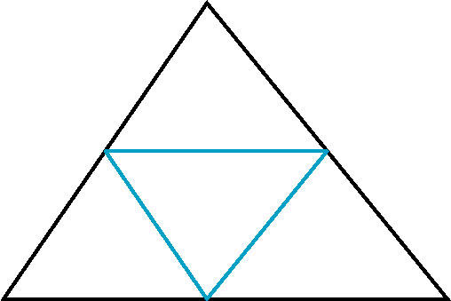
POLYGONS and RECURSION (1)
The output from the gasket program shows considerable structure. (divide the original triangle into four triangles, the middle one containing no points)
This structure suggests a second method for generating the Sierpinski gasket-one that uses polygons instead of points and does not require the use of a random number generator.
  The advantage of using polygons is that we can fill solid areas on the display.
CG
115/11/07

Slide 70
POLYGONS and RECURSION (2)
The strategy is to start with a single triangle, to subdivide it into four smaller triangles by bisecting the sides, and then to remove the middle triangle from further consideration.
We can implement the process that we just described through a recursive program.
We draws a single triangular polygon given three arbitrary vertices.
CG
115/11/07

Slide 71
POLYGONS and RECURSION (3)
void triangle( GLfloat *a, GLfloat *b, GLfloat *c)
/* specify one triangle */
{
glVertex2fv(a);
glVertex2fv(b);
glVertex2fv(c);
}
Suppose that the vertices of the original triangle are given by the array:
GLfloat v[3][2]
The middle points of the sides are given by the array m[3][3]:
for(j=0; j<2; j++) m[0][j]=(v[0][j]+v[1][j])/2.0;
for(j=0; j<2; j++) m[1][j]=(v[0][j]+v[2][j])/2.0;
for(j=0; j<2; j++) m[2][j]=(v[1][j]+v[2][j])/2.0;
CG
115/11/07

Slide 72
POLYGONS and RECURSION (4)
With those six locations, we can use triangle to draw the three triangles formed by (v[0], m[0],m[1]);(v[2], m[1], m[2]); (v[1], m[2], m[0]).
We define the recursive function
void divide_triangle(GLfloat *a, GLfloat *b, GLfloat *c, int k)
that draw the triangles only if k is zero.
CG
115/11/07

Slide 73
POLYGONS and RECURSION (5)
void divide_triangle(GLfloat *a, GLfloat *b, GLfloat *c, int k)
{
/* triangle subdivision using vertex numbers */
GLfloat ab[2], ac[2], bc[2];
int j;
if(m>0)
{
for(j=0; j<2; j++) ab[j]=(a[j]+b[j])/2;
for(j=0; j<2; j++) ac[j]=(a[j]+c[j])/2;
for(j=0; j<2; j++) bc[j]=(b[j]+c[j])/2;
divide_triangle(a, ab, ac, k-1);
divide_triangle(c, ac, bc, k-1);
divide_triangle(b, bc, ab, k-1);
}
else triangle(a,b,c); /* draw triangle at end of recursion */
}
CG
115/11/07

Slide 74
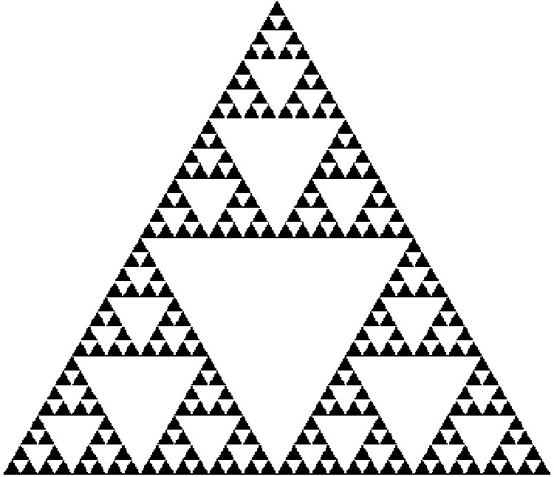
POLYGONS and RECURSION (6)
The display function:
void display()
{
glClear(GL_COLOR_BUFFER_BIT);
glBegin(GL_TRIANGLES);
divide_triangle(v[0], v[1], v[2], n);
glEnd();
glFlush();
}
CG
115/11/07

Slide 75
/* recursive subdivision of triangle to form Sierpinski gasket */
/* number of recursive steps given on command line */
#include<stdlib.h>
#include<stdio.h>
#include<time.h>
#include <GL/glut.h>
/* initial triangle */
GLfloat v[3][2]={{-1.0, -0.58}, {1.0, -0.58}, {0.0, 1.15}};
int n;
void triangle( GLfloat *a, GLfloat *b, GLfloat *c)
/* specify one triangle */
{
glVertex2fv(a);
glVertex2fv(b);
glVertex2fv(c);
}
CG
115/11/07

Slide 76
void divide_triangle(GLfloat *a, GLfloat *b, GLfloat *c, int m)
{
/* triangle subdivision using vertex numbers */
GLfloat v0[2], v1[2], v2[2];
int j;
if(m>0)
{
for(j=0; j<2; j++) v0[j]=(a[j]+b[j])/2;
for(j=0; j<2; j++) v1[j]=(a[j]+c[j])/2;
for(j=0; j<2; j++) v2[j]=(b[j]+c[j])/2;
divide_triangle(a, v0, v1, m-1);
divide_triangle(c, v1, v2, m-1);
divide_triangle(b, v2, v0, m-1);
}
else triangle(a,b,c); /* draw triangle at end of recursion */
}
CG
115/11/07

Slide 77
void display()
{
glClear(GL_COLOR_BUFFER_BIT);
glBegin(GL_TRIANGLES);
divide_triangle(v[0], v[1], v[2], n);
glEnd();
glFlush();
}
void myinit()
{
glMatrixMode(GL_PROJECTION);
glLoadIdentity();
gluOrtho2D(-2.0, 2.0, -2.0, 2.0);
glMatrixMode(GL_MODELVIEW);
glClearColor (1.0, 1.0, 1.0, 1.0);
glColor3f(0.0,0.0,0.0);
}
CG
115/11/07

Slide 78
int main(int argc, char **argv)
{
n=5; /* or set number of subdivision steps here */
glutInit(&argc, argv);
glutInitDisplayMode(GLUT_SINGLE | GLUT_RGB);
glutInitWindowSize(500, 500);
glutCreateWindow("Sierpinski Gasket");
glutDisplayFunc(display);
myinit();
glutMainLoop();
}
CG
115/11/07

Slide 79
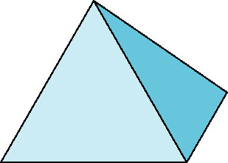
The Three Dimensional Gasket (1)
We convert our two-dimensional Sierpinski gasket program to a program that will generate a three-dimensional gasket.
Use of Three-Dimensional Points
  Because every tetrahedron is convex, the midpoint of a line segment between a vertex and any point inside a tetrahedron is also inside the tetrahedron. (we need four initial vertices to define the tetrahedron)
  The required changes are primary in the function
  display.
GLfloat vertices[4][3]={{0.0,0.0, 0.0},{25.0,50.0, 10.0},
{50.0,25.0, 25.0}, {25.0, 10.0, 25.0}};
GLfloat p[3] ={25.0, 10.0, 25.0};
CG
115/11/07

Slide 80
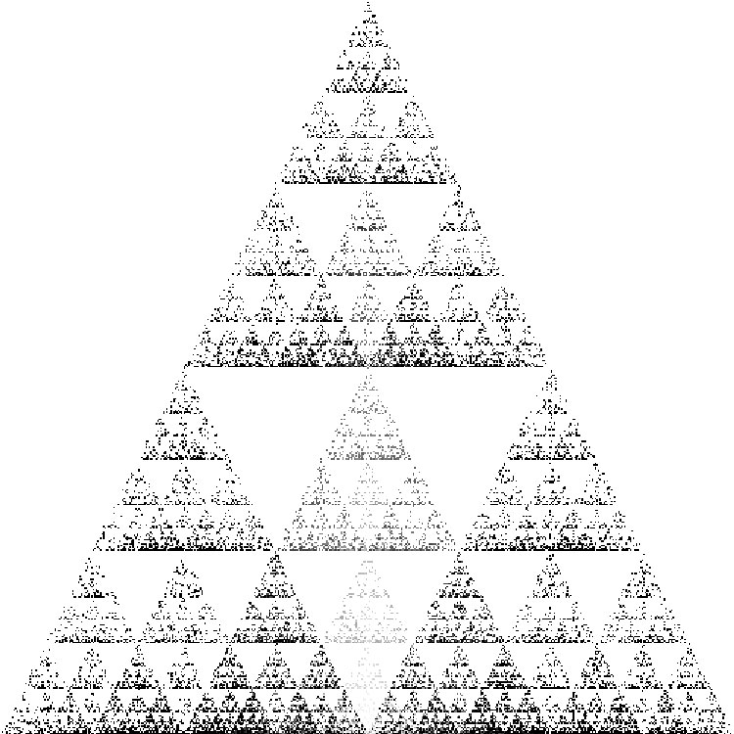
The Three Dimensional Gasket (2)
  We now use the function glVertex3fv to define points. (one problem, it may be difficult to envision the three-dimensional structure)
  We have added a color function that makes the color of each point depend on that point’s location.
  display function is shown in the next slide.
  We define a three-dimenional clipping
  volume (in main.c) by
glOrtho(-50.0, 50.0, -50.0, 50.0, -50.0, 50.0);
CG
115/11/07

Slide 81
void display()
{
int rand();
int i;
j = rand()%4;
p[0] = (p[0]+vertices[j][0])/2.0;
p[1] = (p[1]+vertices[j][1])/2.0;
p[2] = (p[2]+vertices[j][2])/2.0;
glBegin(GL_POINTS)
glColor3f (p[0]/250.0, p[1]/250.0, p[2]/250.0);
glVertex3fv(p);
glEnd();
glFlush();
}
CG
115/11/07

Slide 82
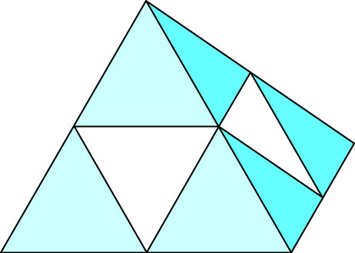
The Three Dimensional Gasket (3)
Use of Polygons in Three Dimensions
  There are now four smaller tetrahedrons, one for each of the original vertices, and another area in the middle that we will discard.
  We will use recursive subdivision to subdivide the
  four tetrahedrons that we keep.
void triangle( GLfloat *a, GLfloat *b, GLfloat *c)
/* specify one triangle */
{
glVertex3fv(a);
glVertex3fv(b);
glVertex3fv(c);
}
CG
115/11/07

Slide 83
void tetra(GLfloat *a, GLfloat *b, GLfloat *c, GLfloat *d)
{
glColor3fv(colors[0]);
triangle(a, b, c);
glColor3fv(colors[1]);
triangle(a, c, d);
glColor3fv(colors[2]);
triangle(a, d, b);
glColor3fv(colors[3]);
triangle(b, d, c);
}
CG
115/11/07

Slide 84
void divide_tetra(GLfloat *a, GLfloat *b, GLfloat *c, GLfloat *d, int m)
{ GLfloat mid[6][3];
int j;
if(m>0)
{ /* compute six midpoints */
for(j=0; j<3; j++) mid[0][j]=(a[j]+b[j])/2;
for(j=0; j<3; j++) mid[1][j]=(a[j]+c[j])/2;
for(j=0; j<3; j++) mid[2][j]=(a[j]+d[j])/2;
for(j=0; j<3; j++) mid[3][j]=(b[j]+c[j])/2;
for(j=0; j<3; j++) mid[4][j]=(c[j]+d[j])/2;
for(j=0; j<3; j++) mid[5][j]=(b[j]+d[j])/2;
/* create 4 tetrahedrons by subdivision */
divide_tetra(a, mid[0], mid[1], mid[2], m-1);
divide_tetra(mid[0], b, mid[3], mid[5], m-1);
divide_tetra(mid[1], mid[3], c, mid[4], m-1);
divide_tetra(mid[2], mid[4], d, mid[5], m-1);
} else(tetra(a,b,c,d)); /* draw tetrahedron at end of recursion */
}
CG
115/11/07

Slide 85
void display()
{
glClear(GL_COLOR_BUFFER_BIT);
glBegin(GL_TRIANGLES);
divide_tetra(v[0], v[1], v[2], v[3], n);
glEnd();
glFlush();
}
CG
115/11/07

Slide 86
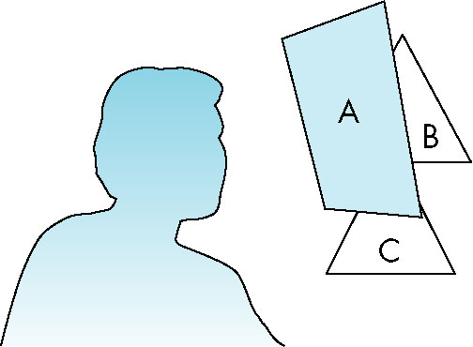
Hidden-Surface Removal
It will have a problem for the above discussion. (hidden-surface problem)
Visible-surface algorithms or
hidden-surface-removal algorithms.
We use a z-buffer algorithm, supported by
OpenGL.
glutInitDisplayMode(GLUT_SINGLE | GLUT_RGB | GLUT_DEPTH);
glEnable(GL_DEPTH_TEST);
glClear(GL_COLOR_BUFFER_BIT | GL_DEPTH_BUFFER_BIT);
CG
115/11/07

Slide 87
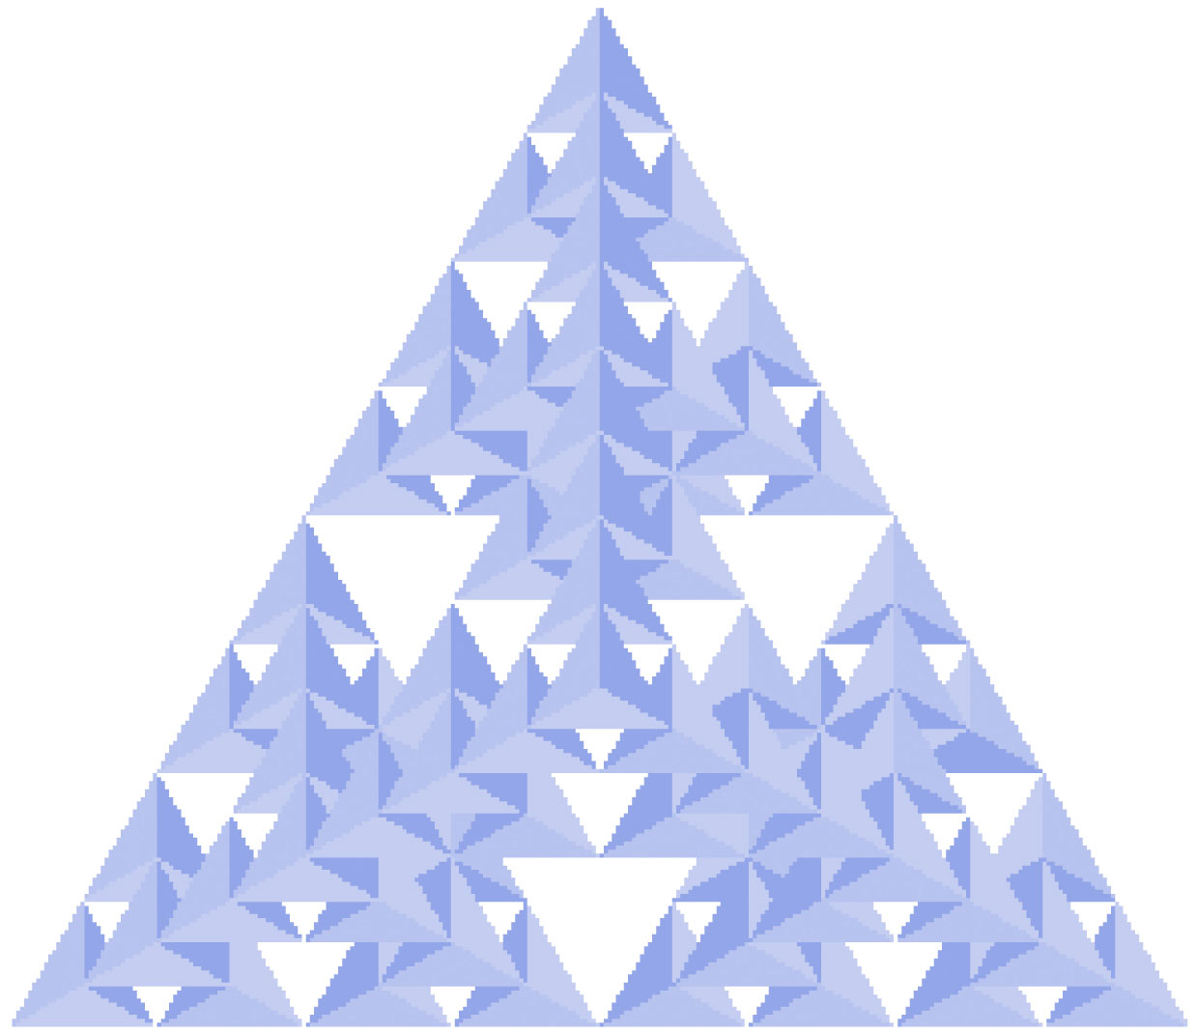
void display()
{
glClear(GL_COLOR_BUFFER_BIT | GL_DEPTH_BUFFER_BIT);
glBegin(GL_TRIANGLES);
divide_tetra(v[0], v[1], v[2], v[3], n);
glEnd();
glFlush();
}
CG
115/11/07

